Slide 1


Factor Analysis: A Data Reduction Technique
Dr. Aidin Namin

Slide 2


Factor Analysis
Factor Analysis can be used for data reduction (i.e., reduce the number of variables).
Summarize the information contained in a larger number of variables into a smaller number of ‘factors’ without significant loss of information.

Slide 3


Factor Analysis
Data reduction is important when you need to measure “fuzzy” concepts such as ‘love’, ‘trust’ or ‘satisfaction’
Ask a series of questions that tap into the different components of the concept.
Too many variables! Factor analysis can help to reduce this dimensionality problem
?
?
?
?

Slide 4
Intuition
Factor analysis assumes that the correlation between a large number of variables is due to them all being dependent on the same small number of “factors”.
Example: Car ratings
Perception of seats
Perception of noise
Perception of “quality”
(Factor)
Perception of smoothness of ride
Perception of AC-system
(Attributes)

Slide 5

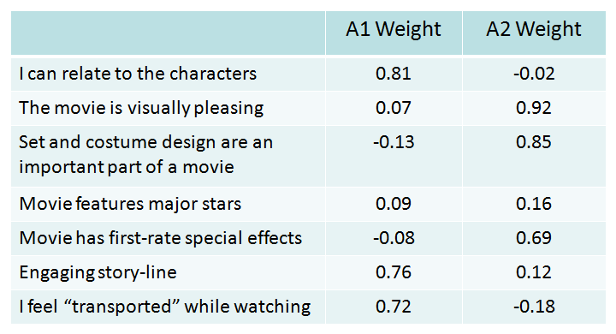

Intuition: Movie Choice Example
Suppose individuals choose movies based on 2 main attributes, each individual has a preference for A1 and A2:
Plot/Story line (A1)
& Production quality (A2)

Slide 6
An Example: Retail Store Choice
A retail chain has identified 40 attributes that influence consumer store choice & they want to understand how consumers make decisions.
Can’t evaluate or act upon 40 separate attributes
Do consumers think in more general evaluative terms, which are in fact composites of these 40 attributes?
If so, they can use those broader dimensions to define
areas of planning and action.
Factor analysis helps identify the broad dimensions–
factors– from data on detailed consumer evaluations.

Slide 7

Attribute Evaluations (9 of 40 are shown)
A1 Price Level
A2 Store Personnel
A3 Return Policy
A4 Product Availability
A5 Product Quality
A6 Assortment Depth
A7 Assortment Width
A8 In-store Service
A9 Store Atmosphere
Very Poor
Very Good
1
7
These evaluations would be obtained for each competing store

Slide 8

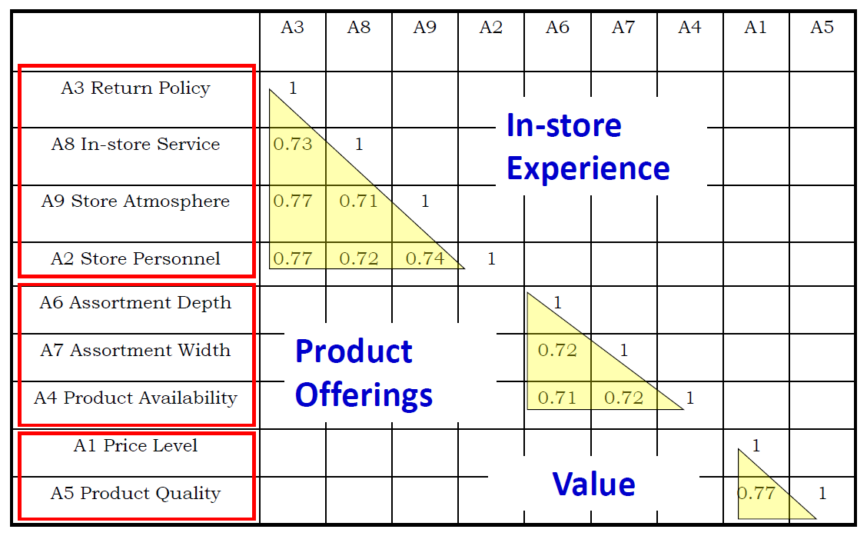
Factor Anal. Evaluates & Rearranges Correlations

Slide 9
Factor Analysis
Variables:
X₁, X ₂ , X₃ ,..., X_{N}
N>L
You pick L! Number of Factors
Factor Scores:
F₁, F₂ , ..., F_{L}
Factor loadings: Weights that determine how each factor is related to each attribute. Help to determine the name that best describes the factor
Factor scores: The respondents’ inferred ratings on the
underlying basic dimension (e.g., a ‘quality’ rating)
9

Slide 10

Example: Attitudes Towards Toothpaste
30 respondents asked to rate the following statements on a 7-
point Scale:
It is important to buy a toothpaste that prevents cavities.
I like a toothpaste that gives shiny teeth.
A toothpaste should strengthen gums.
I prefer a toothpaste that freshens breath.
Prevention of tooth decay is not an important benefit offered by a
toothpaste. (note: reverse!)
The most important consideration in buying a toothpaste is attractive teeth.
1 = strongly disagree; 7 = strongly agree
10

Slide 11

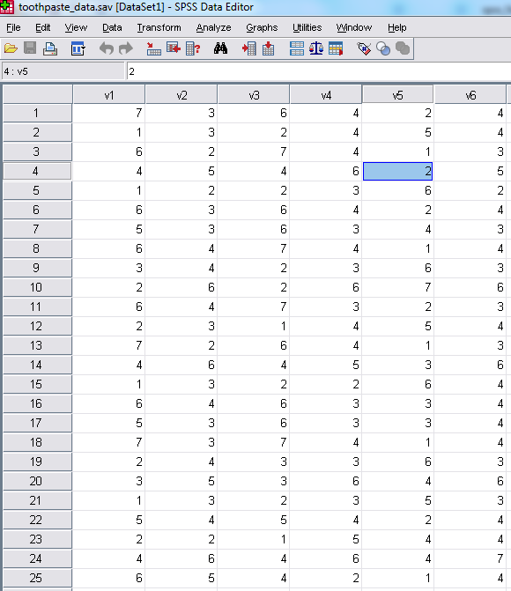
Factor Analysis in SPSS: Toothpaste Data
Data file “toothpaste_data.sav”
6 variables, measured on a scale
from 1 to 7
30 respondents
Objective – run a Factor Analysis to:
Identify correlation structure
among variables.
Link each variable to an underlying
Factor.
Label each factor.
12

Slide 12
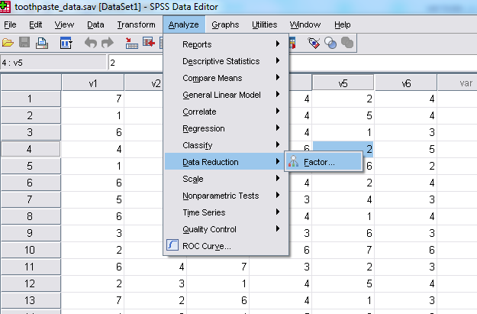
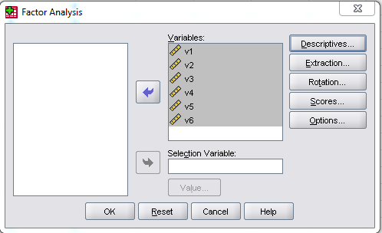
Factor Analysis in SPSS
Select
Analyze →
Data (Dimension) Reduction → Factor
MKT
Select
All the variables and Click Descriptives
13

Slide 13
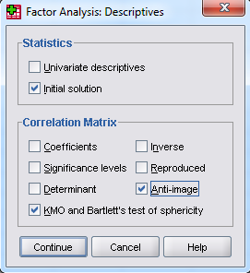
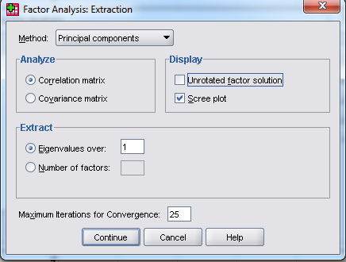
Factor Analysis in SPSS
Next, we will use Descriptives and Extraction Menus
1. Select: Initial Solution in
the Descriptives Menu
2. Select: “Principal Components”, “Scree plot” and „Eigenvalues over:1” in the Extraction menu
3. Run the Factor Analysis by clicking OK in the main menu.
Spring 2012
1
4

Slide 14
Determining the Number of Factors
Next step is to determine the number of factors needed to explain the correlations among the variables
Factors that do not explain much variance in the data are omitted from further consideration. These factors will have eigen-values < 1 in the SPSS output (column ‘Initial Eigen Values’ > ‘Total’)
A further criteria that is often used is the scree-plot (plots eigen- values against the number of factors, in order of extraction). Often an elbow is visible in the curve. Factors up to and including this elbow are selected for analysis, if they have Eigen values above 1
A set of factors that together explain > 70% of the variance in the original data is generally considered acceptable. In our application the total variance explained by the 2 factors is equal to 82%
15

Slide 15
Determining the Number of Factors
The Scree Plot suggests that two factors should be extracted (two eigen-values above 1).
Also, the increase in cumulative % explained variance is small when going from 2 to 3 factors. This is confirmed by the fact that the initial eigen-value for factor 3 is smaller than 1 (= .442). Therefore we choose 2 factors.
Scree Plot
3.0
2.5
2.0
1.5
1.0
Eigenvalue
.5
0.0
1 2
Component Number
3
4
5
6
Spring 2012 MKT 6309
Total Variance Explained
Component | Init ial Eigenv alues |  |  | Extraction Sums of Squared Loadings
 | Total | % of Variance | Cumulativ e % | Total | % of Variance | Cumulativ e %
1 | 2. 731 | 45. 520 | 45. 520 | 2. 731 | 45. 520 | 45. 520
2 | 2. 218 | 36. 969 | 82. 488 | 2. 218 | 36. 969 | 82. 488
3 | .442 | 7. 360 | 89. 848
4 | .341 | 5. 688 | 95. 536
5 | .183 | 3. 044 | 98. 580
6 | .085 | 1. 420 | 100.000
The explained variance by the first 2 factors is 82% which is excellent.
16
Extraction Method: Principal Component Analy sis.

Slide 16
Extracting the Factor Solution
Next, we extract and rotate the factors. Rotation generates a solution where a variable loads highly on only one factor. Important benefit, allows easier interpretation and naming of factors.
Various algorithms for rotation. We will use Varimax, which is the
most commonly used in analytics.
Rotated component matrix is used to label the factors. Use a high- lighter and mark the highest factor loading, in absolute value, in each row. Together, the variables highlighted for each factor help to understand the meaning of the underlying factor.
Final step is to generate the factor scores (weighted average of the variables linked to the factor). These scores approximate the scores respondent would have provided if we were able to ask about the factor in a single question on the survey
17

Slide 17
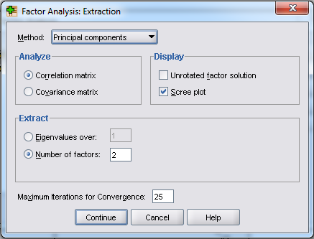
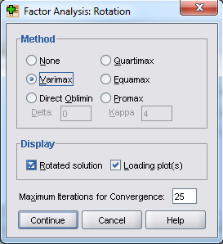
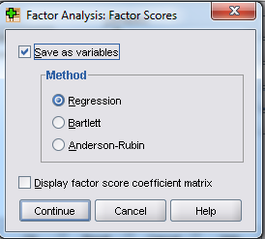
Extracting the Factor Solution
Next, we will use ‘Extraction’, ‘Rotation’ and ‘Scores’ Menus
2. Select: “„Varimax”, “Rotated solution” and “Loading plot(s)” in the Rotation menu
MKT 6309
1. Set „Number of Factors ‟equal to 2 in the „Extraction‟ menu
18
3. Select ‘Save as variables‟
& “Regression” in the Factor
Scores Menu,
Run the Factor Analysis by clicking OK in the main menu.

Slide 18
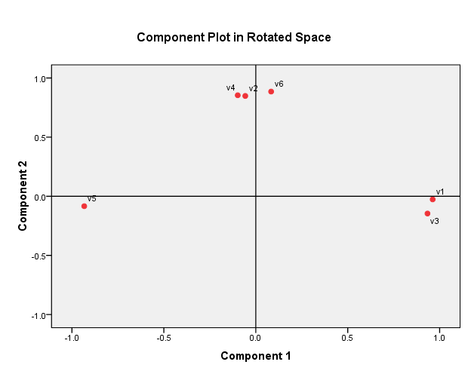
Factor Analysis: Interpret Solution
V1: It is important to buy a toothpaste that prevents cavities.
V2: I like a toothpaste that gives shiny teeth.
V3: A toothpaste should strengthen gums.
V4: I prefer a toothpaste that freshens breath.
V5: Prevention of tooth decay is not an important benefit offered by a toothpaste.
V6: An important consideration in buying a toothpaste is attractive teeth.
1 = disagree; 7 = agree
.
Factor 1: Health Benefits Factor 2: Social Benefits
Rotated Component Matriªx
 | Component
 | 1 | 2
V1 | .962 | -. 027
V2 | -. 057 | .848
V3 | .934 | -. 146
V4 | -. 098 | .854
V5 | -. 933 | -. 084
V6 | .083 | .885
Extraction Method: Principal Component Analy sis.
Rotation Method: Varimax with Kaiser Normalization
a. Rotation converged in 3 iterations.

Slide 19
Testing Appropriateness of Data
Next, we will use Descriptives and Extraction Menus
1. Select: Initial Solution, “KMO and Bartlett‟s test for Sphericity” and “Anti-image” in the Descriptives menu
2. Select: “Principal Components”, “Scree plot”
and „Eigenvalues over:1”
in the Extraction menu
3. Run the Factor Analysis by clicking OK in the main menu.
Spring 2012
2

Slide 20
Are the Data Appropriate for Factor Analysis?
The first step is to determine if the data are appropriate for analysis
Data with limited correlation between variables is generally not appropriate
Three criteria commonly used to test if the data are suited for factor analysis are the KMO-test, Bartlett’s test for sphericity, and the anti- image matrix
The KMO and Bartlett’ test evaluate the available data all together. A KMO value over 0.6 and a significance level for the Bartlett’s test (p-value below
.05) demonstrate that there are at least some significant values in the correlation matrix of the data
The diagonal elements in the anti-image correlation matrix indicate how strongly a single variable is correlated with all the other variables combined. Values above .5 are generally considered acceptable

Slide 21
Factor Analysis: Are the Data Appropriate?
Kaiser-Meyer-Olkin (KMO) > 0.6 and
thus acceptable.
Bartlett’s test statistic is large and
significant as desired.
KMO and Bartlett's Test
Kaiser-Mey er-Olkin Measure of Sampling Adequacy .
.660
Bartlett's Test of Sphericity
Approx. Chi-Square df
Sig.
111.314
15
.000
n
Anti -image Matrices
 | V1 | V2 | V3 | V4 | V5 | V6
Anti-image Cov ariance V1 | .141 | -. 048 | -. 106 | -. 051 | .104 | .073
V2 | -. 048 | .520 | .044 | -. 093 | -. 049 | -. 219
V3 | -. 106 | .044 | .186 | .114 | .025 | -. 073
V4 | -. 051 | -. 093 | .114 | .457 | .025 | -. 206
V5 | .104 | -. 049 | .025 | .025 | .237 | .067
V6 | .073 | -. 219 | -. 073 | -. 206 | .067 | .413
Anti-image Correlation V1 | .621ª | -. 179 | -. 657 | -. 203 | .570 | .303
V2 | -. 179 | .697ª | .140 | -. 192 | -. 139 | -. 474
V3 | -. 657 | .140 | .679ª | .390 | .118 | -. 265
V4 | -. 203 | -. 192 | .390 | .637ª | .074 | -. 474
V5 | .570 | -. 139 | .118 | .074 | .769ª | .213
V6 | .303 | -. 474 | -. 265 | -. 474 | .213 | .561ª
Diagonals of the Anti-Image Correlation Matrix are all larger tha
0.5. Therefore all variables can be
used in the analysis.
a. Measures of Sampling Adequacy(MSA)
23

